Slide 1
Two Alternative Theories of Pricing Behavior
13A

Slide 2
Two Alternate Theories
Two alternative theories argue that oligopolists will form long-lasting cartels.
  Kinked demand curve
  Price leadership
Notes:
Lecture notes:
Note that “long-lasting” is italicized, emphasizing that the cartel will NOT fall apart due to firms defecting from an agreement.

Slide 3
The Kinked Demand Curve Theory
Oligopolists have a greater tendency to respond aggressively to rivals’ price cuts but will ignore price increases.
  Suppose a group of firms have agreed on some price.
  If one of the firms increases its price:
    The other firms keep their prices the same.
  If one of the firms decreases its price:
    The other firms match that price decrease.
Notes:
Lecture notes:
If the “cheater” increases its price, but the other firms keep their prices the same, the cheater will lose customers to the lower priced firms.
If the “cheater” decreases its price, and the other firms match that price cut, the cheater will not gain many more customers.
Basically, you don’t want to be the firm with the high price since that will result in you losing market shares to your competitors.

Slide 4
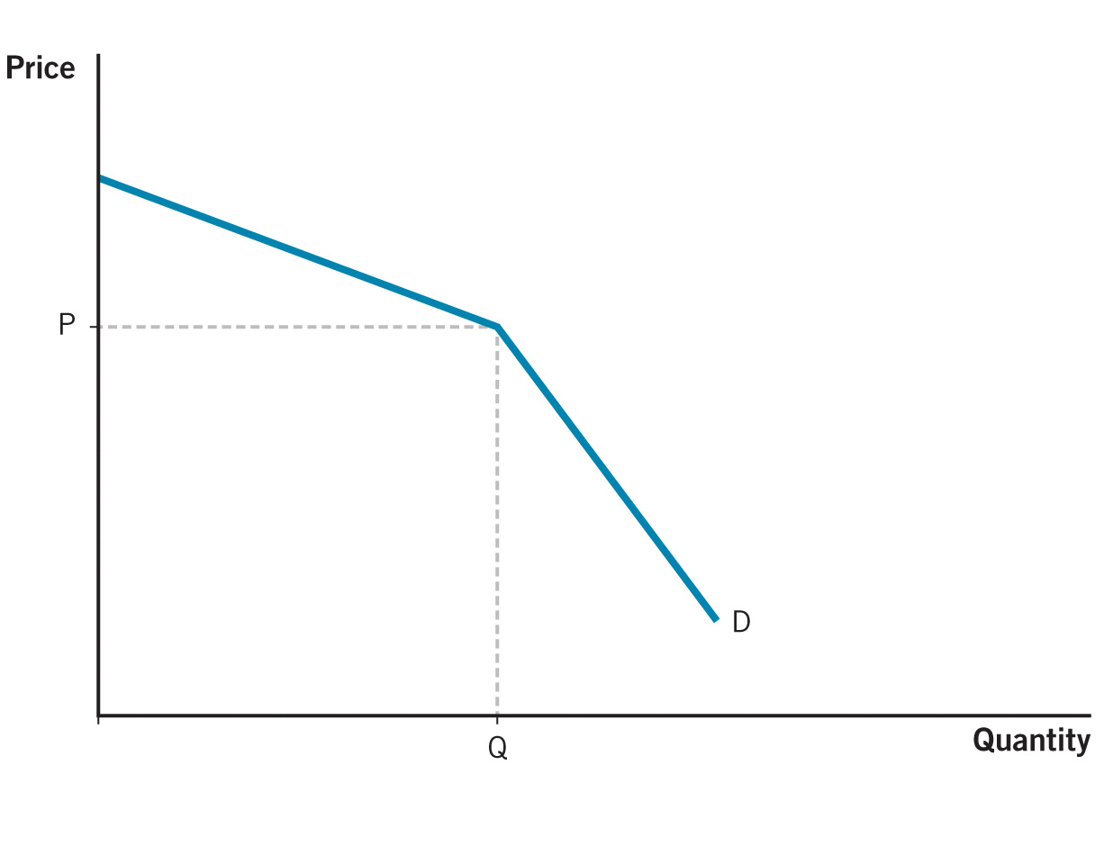
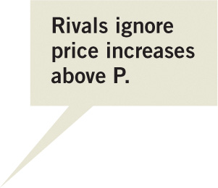
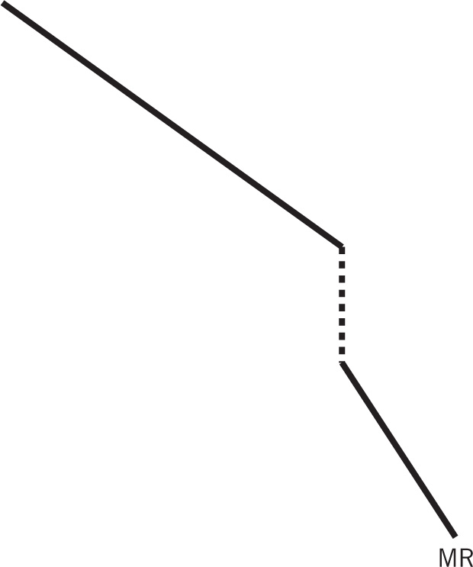
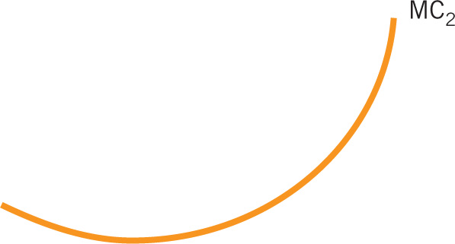
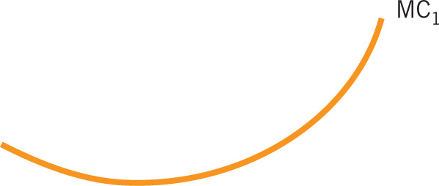
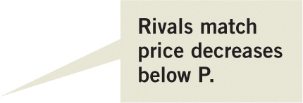
The Kinked Demand Curve
Notes:
Image: Animated Figure 13A.1
Lecture notes:
The figure on the slide starts out with each of the firms in the industry charging P and producing Q.
The demand is kinked because:
First click:
Labels top half of demand curve.
If rivals ignore the price increase, the demand curve is relatively elastic since the firm that increases its price will see a large decrease in quantity demanded.
Second click:
Labels bottom half of demand curve.
If rivals match the price decrease, the demand curve is relatively inelastic since the price cut will not gain many more customers.
Third click:
Draws in the MR curve.
The marginal revenue curve (MR) is discontinuous at the kink. The gap is illustrated by the dashed black vertical line.
Why does this illustrate that a group of oligopolists will keep the same price and output?
Fourth click:
Draws in MC₁ and MC₂.
More than one marginal cost curve intersects marginal revenue at output level Q.
So changes in marginal cost will not lead to a firm to change its price.

Slide 5
Price Leadership
Price leadership
  A single firm that produces a large share of total output is the price leader.
  It sets a price that maximizes its profits, and smaller firms match that price.
  Price leadership is not illegal since it involves tacit collusion, not explicit collusion.
Airlines
  The leader airline sets the fare for a given route, and others follow.
Notes:
Lecture notes:
Problem with Kinked Demand Model:
Can explain why prices oligopoly firms maintain the same price, but cannot explain why prices change (unless there is a large shift in MC)
Explicit collusion:
A funny way to think about explicit collusion is to picture firms verbally agreeing, talking, and shaking hands in a secret location while they all smoke cigars together while laughing.
Tacit collusion:
No “official” deal is made, but there is an “unwritten rule” of cooperation that everyone follows. No one wants to “rock the boat.”

